Slide 1
Preparation for Life Curriculum (5-16)
Designed with a child-centred approach, learners and their individual needs are at the centre
of this curriculum and it is there to support and encourage the development of skills required for adulthood.
Independent Living
Employability
Autism
Friends, Relationships and Community
Good Health

Slide 2
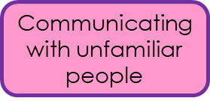
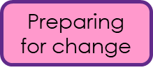
Autism
Autism
Repetitive and restrictive behaviours
Over or under sensitivity to light, sound, taste and touch
Highly focussed interests or hobbies
Extreme Anxiety
Meltdowns and shutdowns
Social communication
Communicating needs
My toolkit

Slide 3
Social communication
Autistic people have differences with interpreting both expressive and receptive language. Some autistic people are non-speaking or have limited speech while other autistic people have very good language skills. Autistic peoples’ communication styles can differ to non-autistic people . This can make it very hard to navigate the neurotypical social world due to double empathy problem.
Further characteristics may include:
Taking things literally and not understanding abstract concepts
Needing extra time to process information or answer questions
Being a Gestalts Language Processor (GLP)
Seek out time alone when overloaded by other people
Information dumping
Direct communication style
Communication skill scan fluctuate dependent on a number of situations e.g. environment, anxiety. (flexibility required)
Routines
With its unwritten rules, the world can seem an unpredictable and confusing place to autistic people. This is why autistic individuals often prefer to have routines so that they know what is going to happen. They may want to travel the same way to and from school or work, wear the same clothes or eat exactly the same food for breakfast.
Change to routine can also be very distressing for autistic people and make them very anxious. It could be having to adjust to big events like Christmas or changing schools, facing uncertainty at work, or something simpler like a bus detour that can trigger their anxiety.

Slide 4
Sensory differences (Over or under sensitivity to light, sound, taste and touch)
Autistic people may experience over- or under-sensitivity to sounds, touch, tastes, smells, light, colours, temperatures or pain. For example, they may find certain background sounds like music in a restaurant, which other people ignore or block out, unbearably loud or distracting. This can cause anxiety or even physical pain.
Many autistic people avoid everyday situations because of their sensitivity differences. Schools, workplaces and shopping centres can be particularly overwhelming and cause sensory overload. There are many simple adjustments that can be made to make environments more autism-friendly. Autistic people may also stim to seek sensory input.
Interoception is the ‘hidden’ 8th sense. Many autistic individuals have reduced interoception awareness 1.e. knowing what is going on inside the body.
Extreme Anxiety
Anxiety disorders are common in autistic people compared to non-autistic people. Contributing factors for autistic people could include sensory differences, communication differences, intolerance to uncertainty, and disruptive changes to routine.
It is important to support autistic people to recognise their emotions and begin to access regulators. Over one third of autistic people have serious mental health issues and too many autistic people are being failed by mental health services.

Slide 5
Meltdowns and shutdowns
When everything becomes too much for an autistic person, they can go into meltdown or shutdown. These are very intense and exhausting experiences. A meltdown happens when someone becomes completely overwhelmed by their current situation. Signs of overload may include extreme irritability, a sense of panic. An autistic person may present as being flight or fight mode when experiencing a meltdown. A shutdown appears less intense to the outside world but can be equally debilitating. Shutdowns are also a response to being overwhelmed, but may appear more passive - eg an autistic person going quiet or 'switching off'. One autistic woman described having a shutdown as: 'just as frustrating as a meltdown, because of not being able to figure out how to react how I want to, or not being able to react at all; there isn’t any ‘figuring out’ because the mind feels like it is past a state of being able to interpret.'
Highly focussed interests (Monotropic mindset)
Many autistic people have intense and highly focused interests, often from a fairly young age. These can change over time or be lifelong. Autistic people can become experts in their special interests and often like to share their knowledge. Like all people, autistic people gain huge amounts of pleasure from pursuing their interests and see them as fundamental to their wellbeing and happiness.
Due to autistic persons intense interests they may find it difficult to switch task and /or transition. Preparation maybe required to support transition.

Slide 6
Food and drink preparation & consumption
Road safety
Independent Living
Taking care of home
Operating appliances
Financial Education
Personal care & hygiene

Slide 7
Dangers and hazards
Enterprise
Teamwork
Employability
Places of work
Safety at work
Roles and responsibilities

Slide 8
Sexual health
Healthy lifestyle choices
Illness and injury
Good Health
Mental health
Physical health
Health management

Slide 9
Healthy relationships
Safety in the community
Travel training
Friends, Relationships and Community
Respecting the environment
Accessing local facilities
Developing friendships

Slide 10
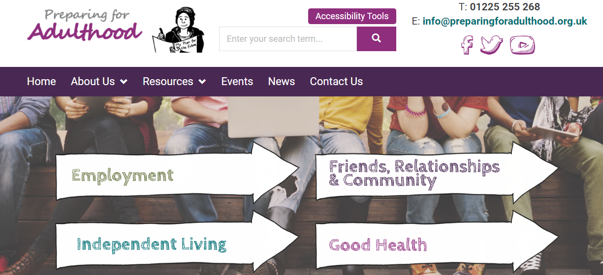
Children and Families Act 2014:
Extension of SEND system to age 25. (EHCP)
Preparing for Adulthood outcomes focus on person-centred reviews from year 9 onwards (annual reviews).

